Slide 1
Deep Generative & Discriminative Models for Speech Recognition
Li Deng
Deep Learning Technology Center
Microsoft Research, Redmond, USA
Machine Learning Conference, Berlin, Oct 5, 2015
Thanks go to many colleagues at DLTC/MSR, collaborating universities,
and at Microsoft’s engineering groups

Slide 2
Outline
Introduction
Part I: Some history
How deep learning entered speech recognition (2009-2010)
Generative & discriminative models prior to 2009
Part II: State of the art
Dominated by deep discriminative models
Deep neural nets (DNN) & many of the variants
Part III: Prospects
Integrating deep generative/discriminative models
Deep multimodal and semantic modeling

Slide 3
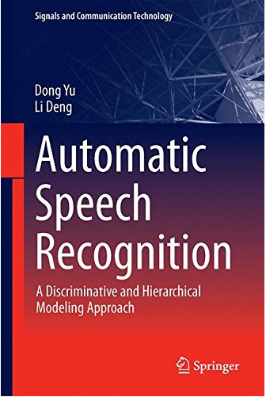
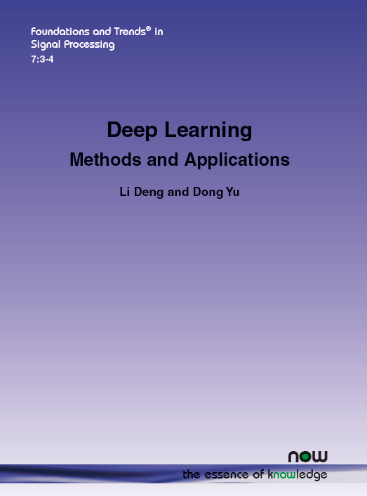
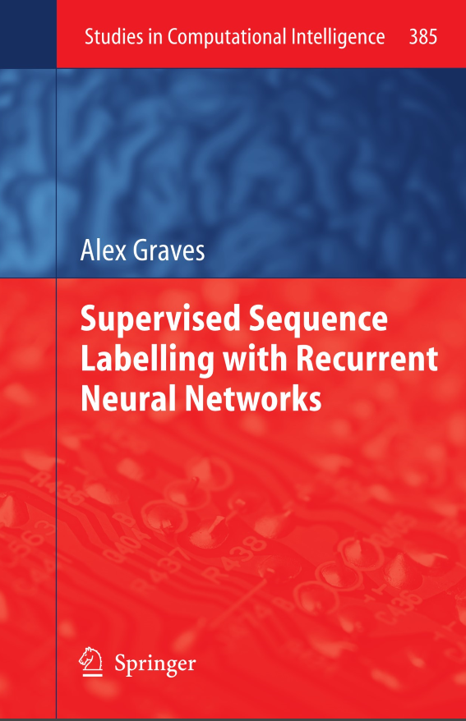
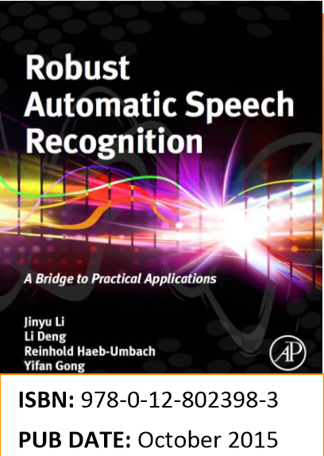
Recent Books on the Topic
L. Deng and D. Yu (2014) "Deep Learning: Methods and Applications,“ NOW Publishers http://research.microsoft.com/pubs/209355/DeepLearning-NowPublishing-Vol7-SIG-039.pdf
D. Yu and L. Deng (2014). "Automatic Speech Recognition: A Deep Learning Approach,” Springer.
A. Graves (2012) “Supervised Sequence Labeling with Recurrent Neural Nets,” Springer.
J. Li, L. Deng, R. Haeb-Umbach, Y. Gong (2015) “Robust Automatic Speech Recognition --- A bridge to practical applications,” Academic Press.
A Deep-Learning Approach

Slide 4
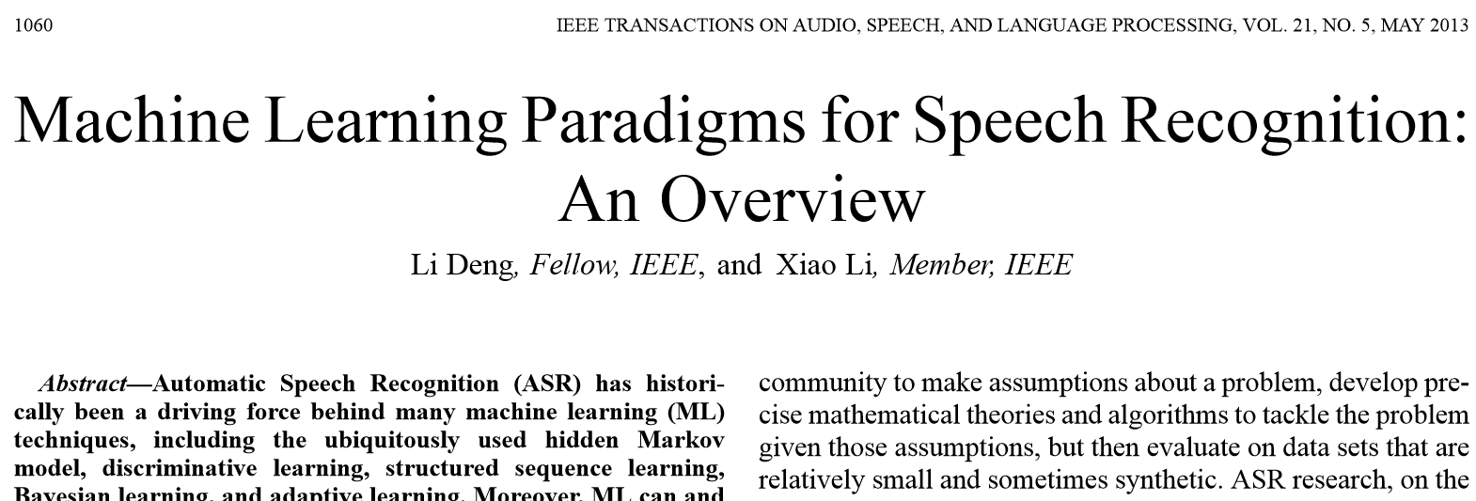
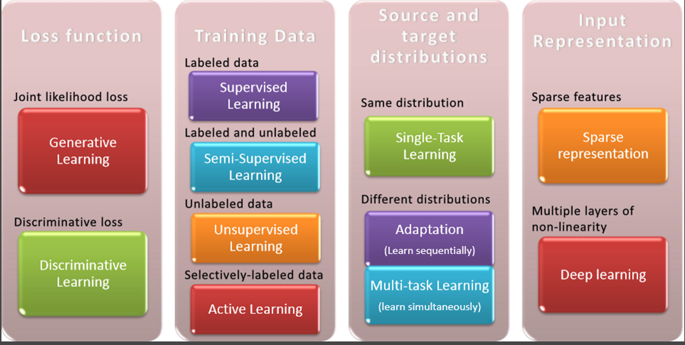
1060-1089

Slide 5
 | Deep Discriminative NN | Deep Generative Models
Structure | Graphical; info flow: bottom-up | Graphical; info flow: top-down
Incorp constraints & domain knowledge | Harder; less fine-grained | Easier; more fine grained
Semi/unsupervised | Hard or impossible | Easier, at least possible
Interpretation | Harder | Easy (generative “story” on data and hidden variables)
Representation | Distributed | Localist (mostly); can be distributed also
Inference/decode | Easy | Harder (but note recent progress)
Scalability/compute | Easier (regular computes/GPU) | Harder (but note recent progress)
Incorp. uncertainty | Hard | Easy
Empirical goal | Classification, feature learning, … | Classification (via Bayes rule), latent variable inference…
Terminology | Neurons, activation/gate functions, weights … | Random vars, stochastic “neurons”, potential function, parameters …
Learning algorithm | A single, unchallenged, algorithm -- BackProp | A major focus of open research, many algorithms, & more to come
Evaluation | On a black-box score – end performance | On almost every intermediate quantity
Implementation | Hard (but increasingly easier) | Standardized but insights needed
Experiments | Massive, real data | Modest, often simulated data
Parameterization | Dense matrices | Sparse (often PDFs); can be dense
Notes:
Expanding from Eric Xing’s list
Pros and cons of both machineries; Let’s take the best of both worlds, as the main theme of this talk.
For “learning algorithms”: A major focus of open research, many algorithms, & more to come → this includes back-prop (hot in graphical models now).

Slide 6
Outline
Introduction
Part I: Some history
How deep learning entered speech recognition (2009-2010)
Generative & discriminative models prior to 2009
Part II: State of the art
Dominated by deep discriminative models
Deep neural nets (DNN) & many of the variants
Part III: Prospects
Integrating deep generative/discriminative models
Deep multimodal and semantic modeling

Slide 7
(Shallow) Neural Networks for Speech Recognition (prior to the rise of deep learning 2009-2010)
Temporal & Time-Delay (1-D Convolutional) Neural Nets
Atlas, Homma, and Marks, “An Artificial Neural Network for Spatio-Temporal Bipolar Patterns, Application to Phoneme Classification,” NIPS, 1988.
Waibel, Hanazawa, Hinton, Shikano, Lang. “Phoneme recognition using time-delay neural networks.” IEEE Transactions on Acoustics, Speech and Signal Processing, 1989.
Hybrid Neural Nets-HMM
Morgan and Bourlard. “Continuous speech recognition using MLP with HMMs,” ICASSP, 1990.
Recurrent Neural Nets
Bengio. “Artificial Neural Networks and their Application to Speech/Sequence Recognition”, Ph.D. thesis, 1991.
Robinson. “A real-time recurrent error propagation network word recognition system,” ICASSP 1992.
Neural-Net Nonlinear Prediction
Deng, Hassanein, Elmasry. “Analysis of correlation structure for a neural predictive model with applications to speech recognition,” Neural Networks, vol. 7, No. 2, 1994.
Bidirectional Recurrent Neural Nets
Schuster, Paliwal. "Bidirectional recurrent neural networks," IEEE Trans. Signal Processing, 1997.
Neural-Net TANDEM
Hermansky, Ellis, Sharma. "Tandem connectionist feature extraction for conventional HMM systems." ICASSP 2000.
Morgan, Zhu, Stolcke, Sonmez, Sivadas, Shinozaki, Ostendorf, Jain, Hermansky, Ellis, Doddington, Chen, Cretin, Bourlard, Athineos, “Pushing the envelope - aside [speech recognition],” IEEE Signal Processing Magazine, vol. 22, no. 5, 2005.
← DARPA EARS Program 2001-2004: Novel Approach I (Novel Approach II: Deep Generative Model)
Bottle-neck Features Extracted from Neural-Nets
Grezl, Karaﬁat, Kontar & Cernocky. “Probabilistic and bottle-neck features for LVCSR of meetings,” ICASSP, 2007.
1988
1989
1990
1991
1992
1994
1997
2000
2005
2007
Notes:
Arden House, NY, 1988; TDNN beating HMM; second year; reverse by BBN
Many very influential NN researchers left NN to pursue graphical modeling (M Jordon, e.g.; also hinton on generative models) amusing piece of history
1994 NN and drop out to pursue deep generative DBN while others pursuing NN; 2009 returning to NN...
With Hinton; on RBM/DBN/DNN
With Dong, remove DBN pre-training with larger data; patent filed.

Slide 8
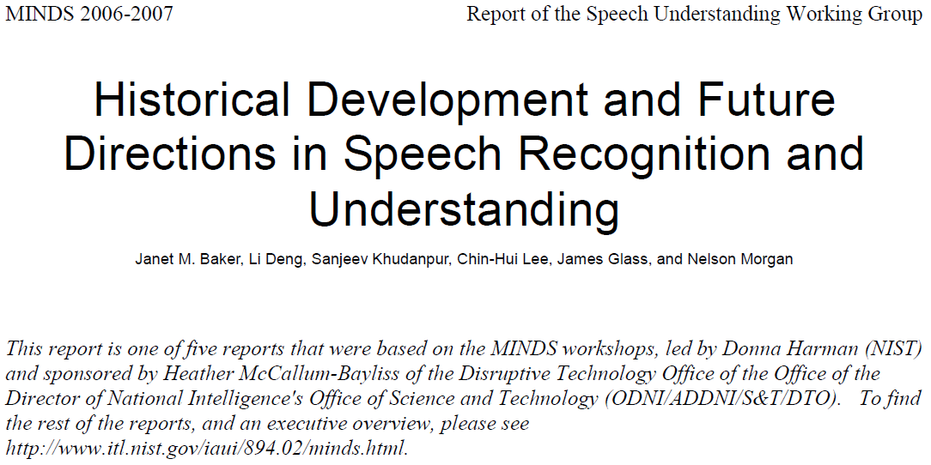
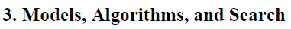
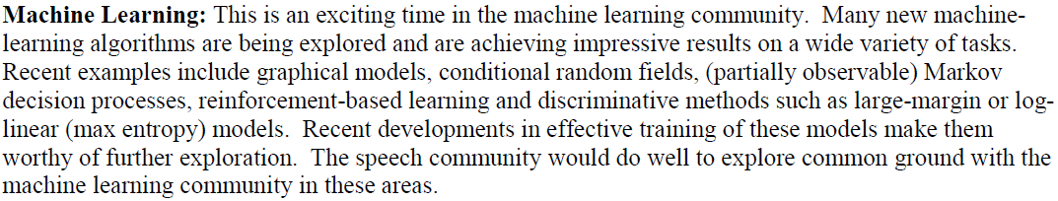
…, …, …
Notes:
To show the un-popularity of NN, I show this historical report written, sponsored by the Predecessor of I-ARPA.
After 4 days of close-door meetings, this 20+ page report was written, where in the ML section, nowhere neural nets were mentioned. Rather, graphical models and CRFs are at a higher priority

Slide 9
Deep Generative Models for Speech Recognition (prior to the rise of deep learning)
Segment & Nonstationary-State Models
Digalakis, Rohlicek, Ostendorf. “ML estimation of a stochastic linear system with the EM alg & application to speech recognition,” IEEE T-SAP, 1993
Deng, Aksmanovic, Sun, Wu, Speech recognition using HMM with polynomial regression functions as nonstationary states,” IEEE T-SAP, 1994.
Hidden Dynamic Models (HDM)
Deng, Ramsay, Sun. “Production models as a structural basis for automatic speech recognition,” Speech Communication, vol. 33, pp. 93–111, 1997.
Bridle et al. “An investigation of segmental hidden dynamic models of speech coarticulation for speech recognition,” Final Report Workshop on Language Engineering, Johns Hopkins U, 1998.
Picone et al. “Initial evaluation of hidden dynamic models on conversational speech,” ICASSP, 1999.
Deng and Ma. “Spontaneous speech recognition using a statistical co-articulatory model for the vocal tract resonance dynamics,” JASA, 2000.
Structured Hidden Trajectory Models (HTM)
Zhou, et al. “Coarticulation modeling by embedding a target-directed hidden trajectory model into HMM,” ICASSP, 2003. ← DARPA EARS Program 2001-2004: Novel Approach II
Deng, Yu, Acero. “Structured speech modeling,” IEEE Trans. on Audio, Speech and Language Processing, vol. 14, no. 5, 2006.
Switching Nonlinear State-Space Models
Deng. “Switching Dynamic System Models for Speech Articulation and Acoustics,” in Mathematical Foundations of Speech and Language Processing, vol. 138, pp. 115 - 134, Springer, 2003.
Lee et al. “A Multimodal Variational Approach to Learning and Inference in Switching State Space Models,” ICASSP, 2004.
1993
1994
1997
1998
1999
2000
2003
2006

Slide 10
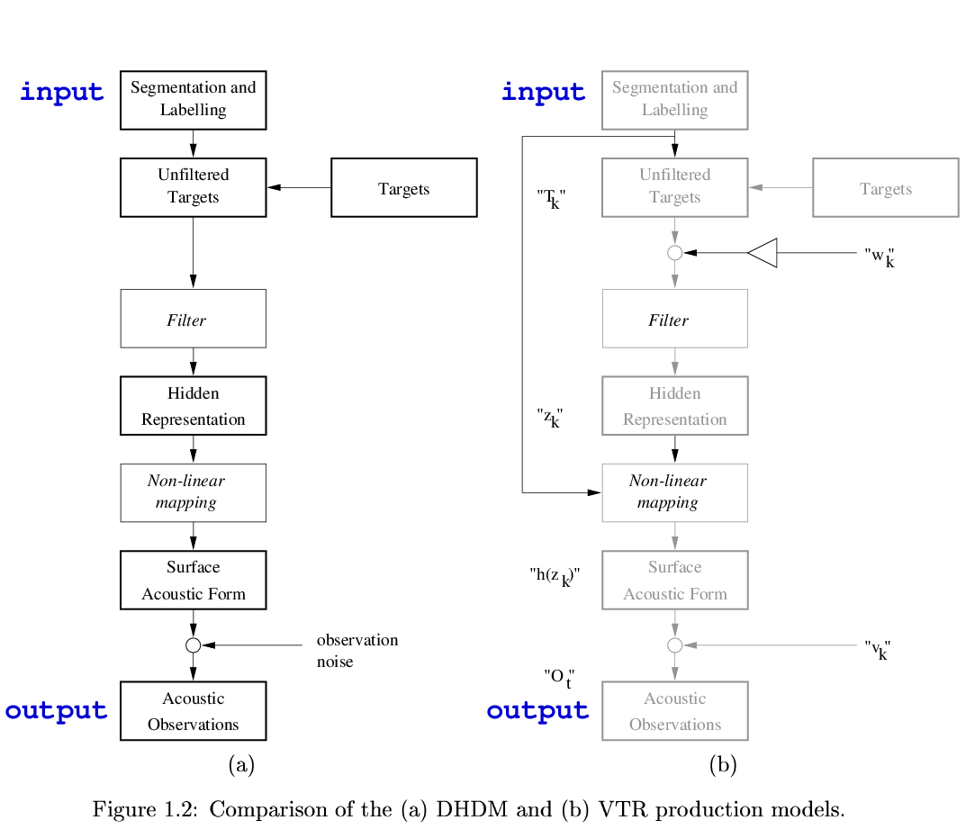
Deterministic
HDM
Statistical
HDM
Bridle, Deng, Picone, Richards, Ma, Kamm, Schuster, Pike, Reagan. Final Report for Workshop on Language Engineering, Johns Hopkins University, 1998.
Notes:
Two versions of the HDM, one deterministic (backprop for learning), the other statistical (EM and EKF for learning). Both making lots of “reasonable” assumptions.
Nonlinear mappings here are done by a shallow NN in both versions, believing they are universal approximators.
Evaluated on Switchboard task -→ very minor improvements, to our disappointment. We now understand why and you will during Part II in discussing RNN vs. HDM. but nevertheless this is a step stone to DNN
Note in both Bridle/deng models: local, not distributed, representations of linguistic outputs are used, much like GMM-HMM. (Hinton in 2009 asked me to show state of the art gmm-hmm system. Mlf files. “Crazy idea to use so many GMMs for each label”. Not the case in DNN: weights are inherently shared across all classes to represent them jointly. This is called distributed representations. Now back to deep generative models. Despite the use of NN and back-prop and despite the ability to incorporate problem constraints, the representations are not distributed.

Slide 11
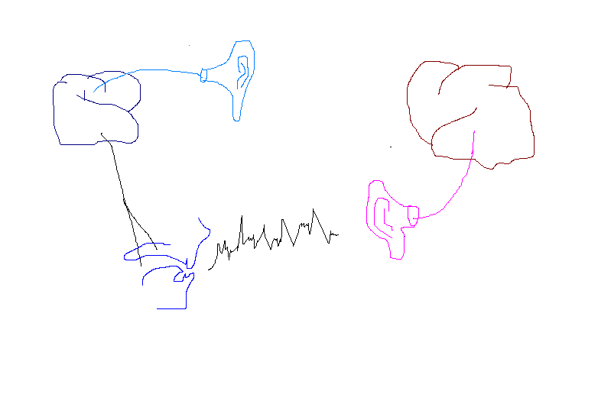
HDM: A Deep Generative Model of Speech Production/Perception --- Perception as “variational inference” (1997-2007)
SPEAKER
targets
articulation
message
distortion-free acoustics
distorted acoustics
motor/articulators
Speech Acoustics
distortion factors &
feedback to articulation

Slide 12
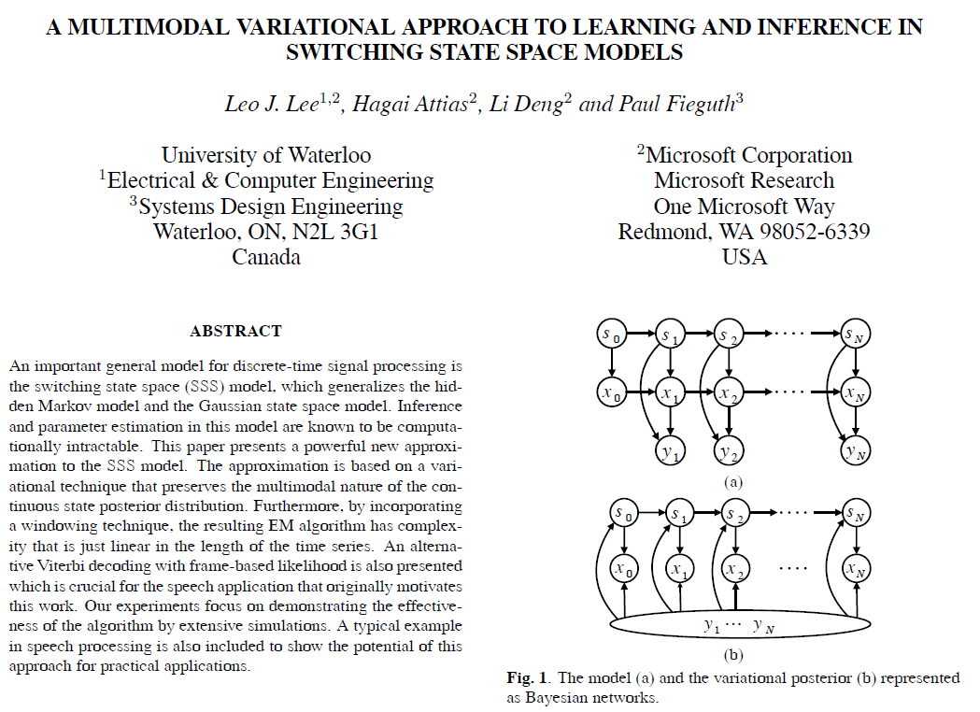
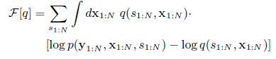
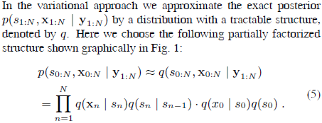
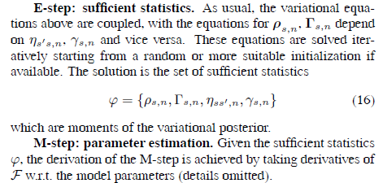
ICASSP-2004
Auxiliary function:
Notes:
Crazy idea of variational Bayes for learning such intractable deep generative model:
During E step, assume factorization of posterior probabilities --- destroying essential dynamics and hoping M step can recover the errors.

Slide 13
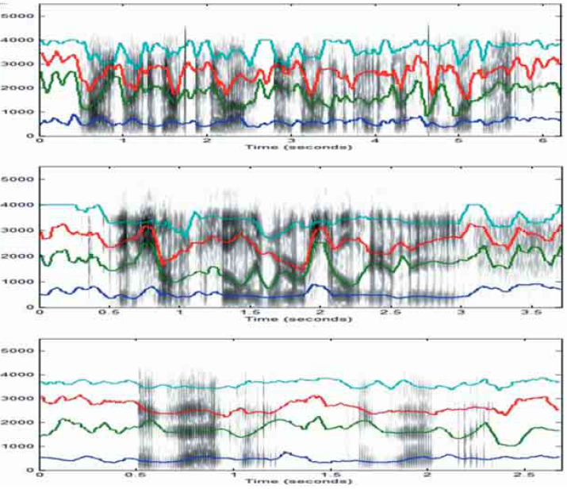
Surprisingly Good Inference Results for Continuous Hidden States
By-product: accurately tracking dynamics of resonances (formants) in vocal tract (TIMIT & SWBD).
Best formant tracker by then in speech analysis; used as basis to form a formant database as “ground truth”
We thought we solved the ASR problem, except
“Intractable” for decoding
Deng & Huang, Challenges in Adopting Speech Recognition, Communications of the ACM, vol. 47, pp. 69-75, 2004.
Deng, Cui, Pruvenok, Huang, Momen, Chen, Alwan, A Database of Vocal Tract Resonance Trajectories for Research in Speech , ICASSP, 2006.
Notes:
So only need simplification of this deep generative model to solve “remaining” engineering problem
Not as good for inference of top-layer, symbolic sequences (i.e. ASR)
Jelinek gave good advice on why and how to simplify.

Slide 14
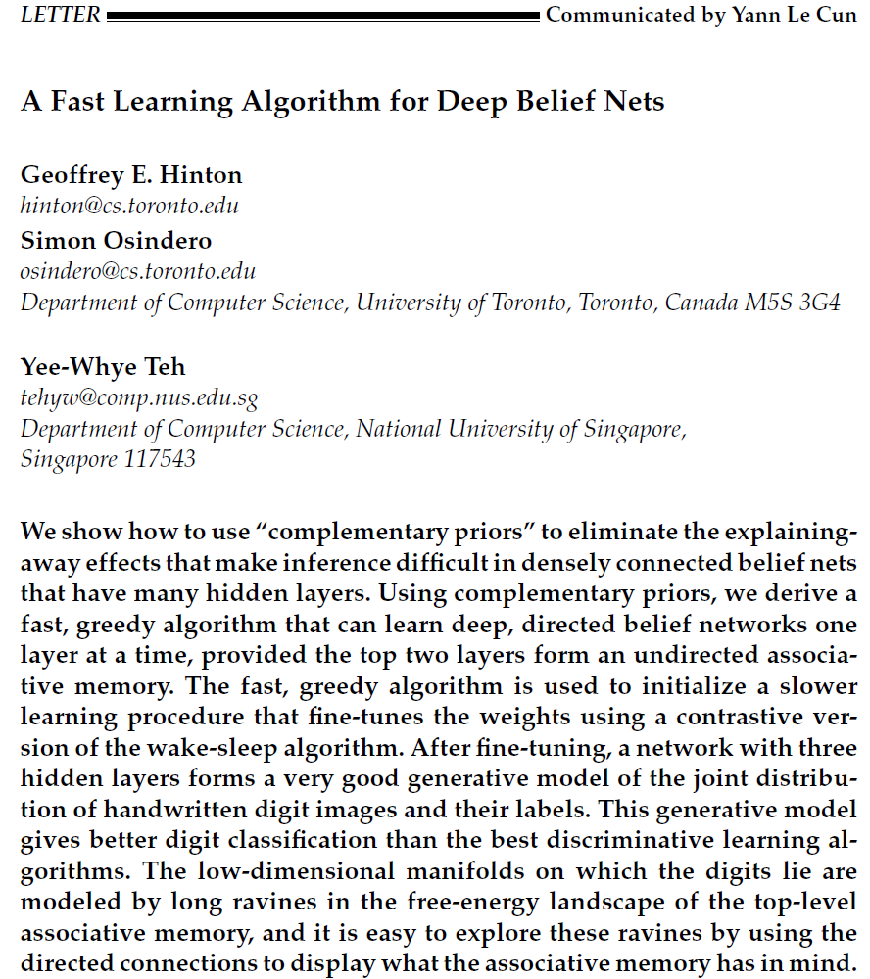
Another Deep Generative Model (developed outside speech)
Sigmoid belief nets & wake/sleep alg. (1992)
Deep belief nets (DBN, 2006);
→ Start of deep learning
Totally non-obvious result:
Stacking many RBMs (undirected)
→ not Deep Boltzmann Machine (DBM, undirected)
but a DBN (directed, generative model)
Excellent in generating images & speech synthesis
Similar type of deep generative models to HDM
But simpler: no temporal dynamics
With very different parameterization
Most intriguing of DBN: inference is easy
(i.e. no need for approximate variational Bayes)
← ”Restriction” of connections in RBM
Pros/cons analysis→ Hinton coming to MSR 2009
Notes:
In the mean time, there was parallel development of deep generative models in ML/NIPS community. NN is very unpopular; papers automatically rejected.
APSIPA tutorial on DBN for image generation, HM picked it up quickly and helped create one of the first deep-learning based speech synthesizer

Slide 15
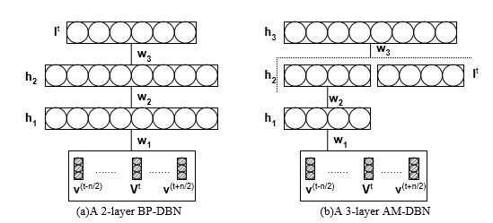
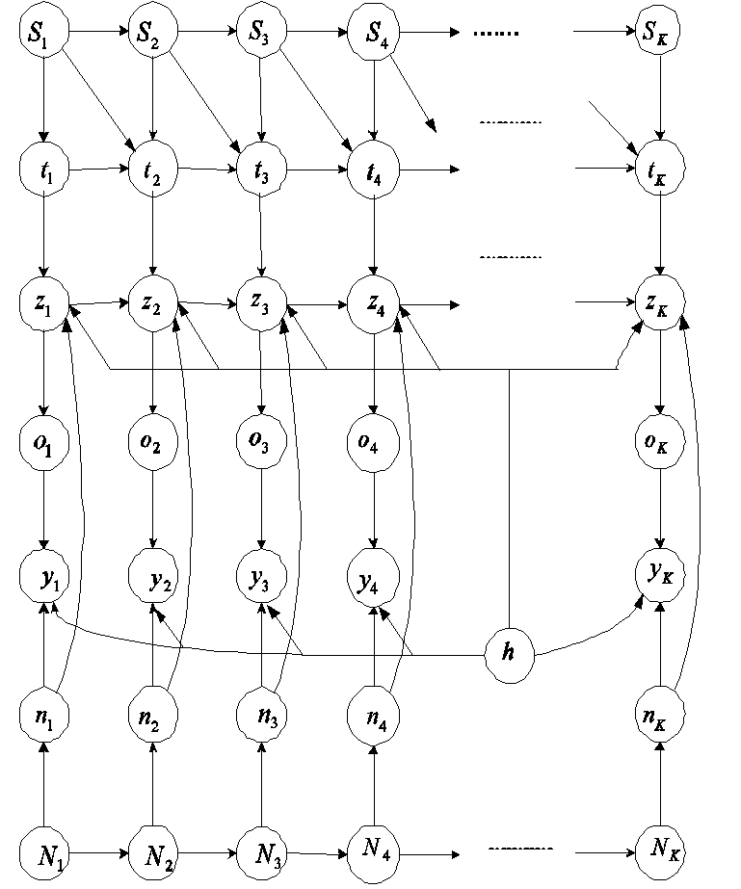
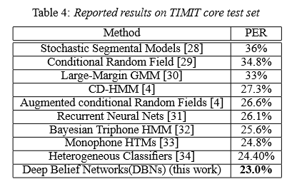
This is a very different kind of deep generative model
(Mohamed, Dahl, Hinton, 2009, 2012)
(Deng et al., 2006; Deng & Yu, 2007)
(after adding Backprop to the generative DBN)

Slide 16
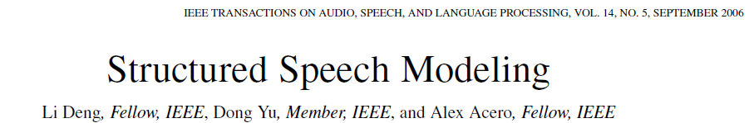
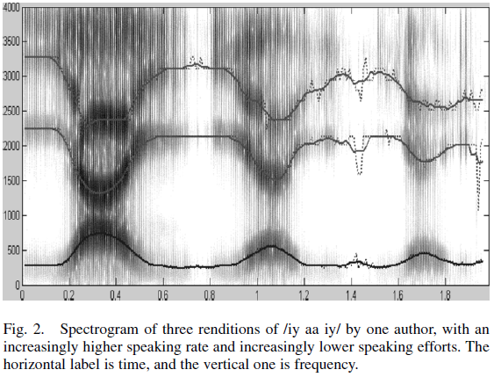
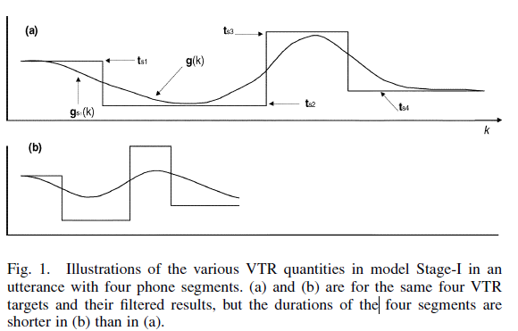
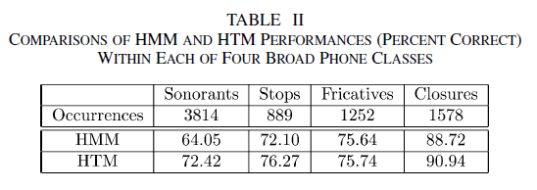
d
Error Analysis
Elegant model formulation & knowledge incorporation
Strong empirical results: 96% TIMIT accuracy with Nbest=1001; 75.2% lattice decoding w. monophones; fast approx. training
Still very expensive for decoding; could not ship (very frustrating!)
-- DBN/DNN made many new errors
on short, undershoot vowels -- 11 frames contain too much “noise”
Notes:
This is a simplified model, hoping to speed up decoding
Fred Jelinek idea at JHU (on Nbest 1001)

Slide 17
Academic-Industrial Collaboration (2009,2010)
I invited Geoff Hinton to work with me at MSR, Redmond
Well-timed academic-industrial collaboration:
Speech industry searching for new solutions while “principled” deep generative approaches could not deliver
Academia developed deep learning tools (e.g. DBN 2006) looking for applications
Add Backprop to deep generative models (DBN) → DBN-DNN (hybrid generative/discriminative)
Advent of GPU computing (Nvidia CUDA library released 2007-2008)
Big training data in speech recognition were already available
Notes:
Alternative Kluge 2 for inference problem
If no Kluge 1 but kluge 2 → RNN
Due to frustrations of both industry and academic.
Overcoming limitations of DBN/DNN:
RNN: Reminiscent of RNN with thin frames vs. DNN with thick frames (see Google’s paper on LSTM-RNN using single frames)
Mixed generative/discriminative
No need for DBN pre-training when large training data are available

Slide 18
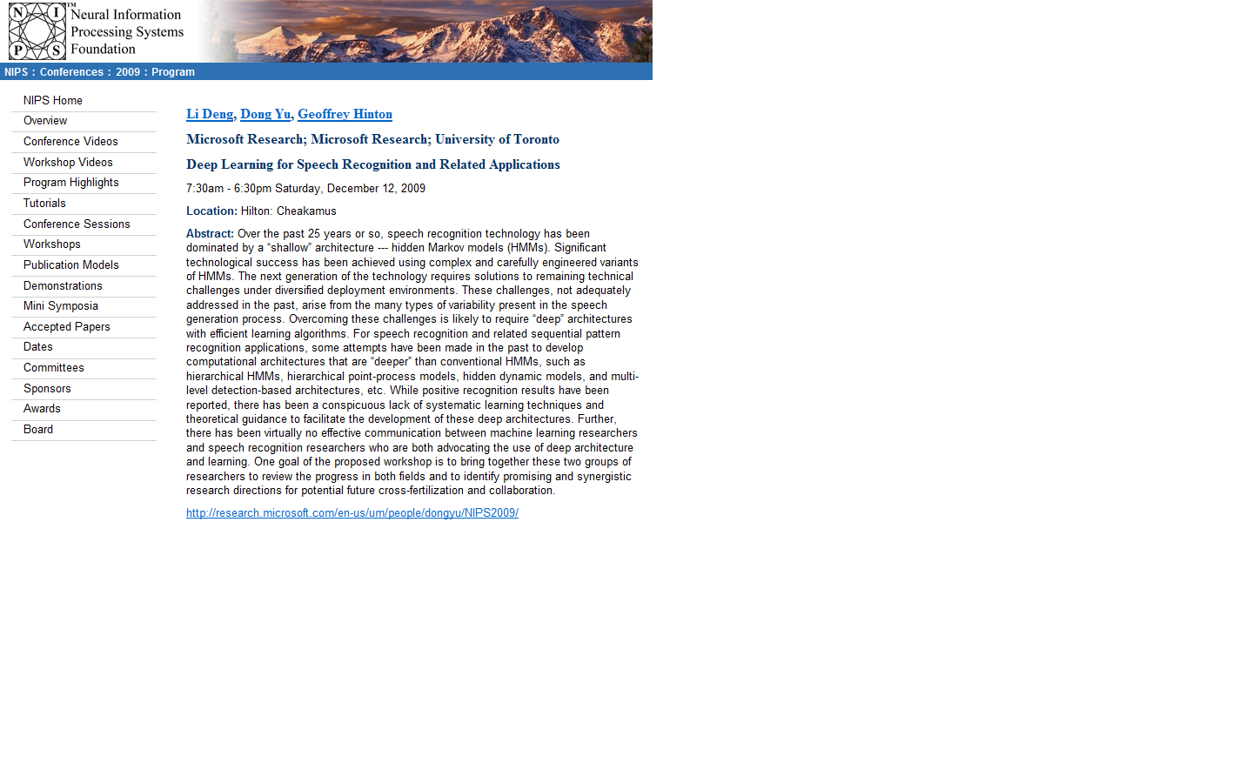
Invitee 1: give me one week to decide …,…
Not worth my time to fly to Vancouver for this…
Mohamed, Dahl, Hinton, Deep belief networks for phone recognition, NIPS 2009 Workshop on Deep Learning, 2009
Yu, Deng, Wang, Learning in the Deep-Structured Conditional Random Fields, NIPS 2009 Workshop on Deep Learning, 2009
…, …, …
Notes:
Several in the audience attended and gave invited talks at workshop (“deep speech recognition” is born; inroad of Deep learning into ASR)
In planning this workshop, GH and I were looking at who to invite.
Remember a very well-known person (nameless now) in all NN, deep generative model, and ASR, declined (something like “give me one week to think whether it is worth my time to travel to Whistler”); one week later, answer is “no”. Other invitees who declined --- “crazy idea of using waveform for ASR, like using photons for image recognition” (now we have a good paper at Interspeech-2014, Hermann Ney’s group, on this “crazy idea”)

Slide 19
Expanding DNN at Industry Scale
Scale DNN’s success to large speech tasks (2010-2011)
Grew output neurons from context-independent phone states (100-200) to context-dependent ones (1k-30k) → CD-DNN-HMM for Bing Voice Search and then to SWBD tasks
Motivated initially by saving huge MSFT investment in the speech decoder software infrastructure
CD-DNN-HMM also gave much higher accuracy than CI-DNN-HMM
Discovered that with large training data Backprop works well without DBN pre-training by understanding why gradients often vanish (patent filed for “discriminative pre-training” 2011)
Engineering for building large speech systems:
Combined expertise in DNN (esp. with GPU implementation) and speech recognition
Collaborations among MSRR, MSRA, academic researchers
Yu, Deng, Dahl, Roles of Pre-Training and Fine-Tuning in Context-Dependent DBN-HMMs for Real-World Speech Recognition, in NIPS Workshop on Deep Learning, 2010.
Dahl, Yu, Deng, Acero, Large Vocabulary Continuous Speech Recognition With Context-Dependent DBN-HMMS, in Proc. ICASSP, 2011.
Dahl, Yu, Deng, Acero, Context-Dependent Pre-trained Deep Neural Networks for Large Vocabulary Speech Recognition, in IEEE Transactions on Audio, Speech, and Language Processing (2013 IEEE SPS Best Paper Award) , vol. 20, no. 1, pp. 30-42, January 2012.
Seide, Li, Yu, "Conversational Speech Transcription Using Context-Dependent Deep Neural Networks", Interspeech 2011, pp. 437-440.
Hinton, Deng, Yu, Dahl, Mohamed, Jaitly, Senior, Vanhoucke, Nguyen, Sainath, Kingsbury, Deep Neural Networks for Acoustic Modeling in SpeechRecognition, in IEEE Signal Processing Magazine, vol. 29, no. 6, pp. 82-97, November 2012
Sainath, T., Kingsbury, B., Ramabhadran, B., Novak, P., and Mohamed, A. “Making deep belief networks effective for large vocabulary continuous speech recognition,” Proc. ASRU, 2011.
Sainath, T., Kingsbury, B., Soltau, H., and Ramabhadran, B. “Optimization Techniques to Improve Training Speed of Deep Neural Networks for Large Speech Tasks,” IEEE Transactions on Audio, Speech, and Language Processing, vol.21, no.11, pp.2267-2276, Nov. 2013.
Jaitly, N., Nguyen, P., Senior, A., and Vanhoucke, V. “Application of Pretrained Deep Neural Networks to Large Vocabulary Speech Recognition,” Proc. Interspeech, 2012.

Slide 20
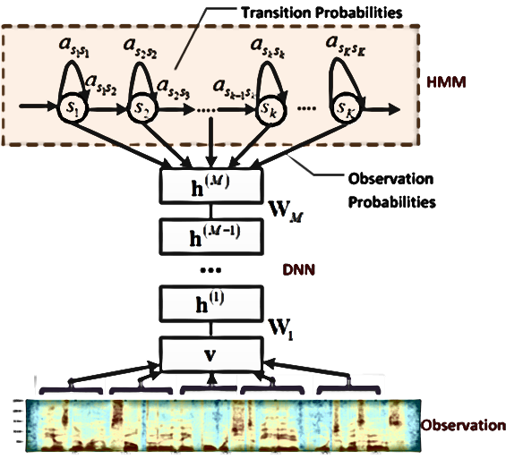
Context-Dependent DNN-HMM
Model tied triphone states directly
Many layers of nonlinear feature transformation + SoftMax

Slide 21
DNN vs. Pre-DNN Prior-Art
Table: TIMIT Phone recognition (3 hours of training)
Features | Setup | Error Rates
Pre-DNN | Deep Generative Model | 24.8%
DNN | 5 layers x 2048 | 23.4%
~10% relative
improvement
Table: Voice Search SER (24-48 hours of training)
Features | Setup | Error Rates
Pre-DNN | GMM-HMM with MPE | 36.2%
DNN | 5 layers x 2048 | 30.1%
~20% relative
improvement
Table: SwitchBoard WER (309 hours training)
Features | Setup | Error Rates
Pre-DNN | GMM-HMM with BMMI | 23.6%
DNN | 7 layers x 2048 | 15.8%
~30% relative
Improvement
For DNN, the more data, the better!
Notes:
Let’s first review the record-breaking performance of the DNN technology
TIMIT--- earlier experiment 2009-2010; 7700 test tokens; remember most of them
10%
20%
30%
With 3 orders of magnitude increase of the training size.
Opposite to other technologies; smaller tasks harder rather than easier (need to regularize more)
This set of results, coming from MSR, really excited the entire speech recog research community and industry.

Slide 22


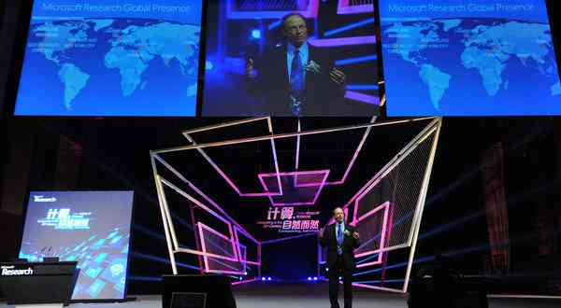
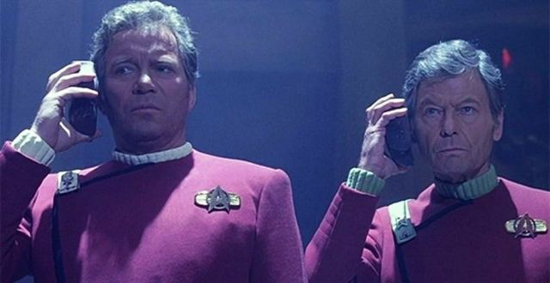
Scientists See Promise in Deep-Learning Programs
John Markoff
November 23, 2012
Rick Rashid in Tianjin, China, October, 25, 2012
Deep learning
technology enabled
speech-to-speech
translation
A voice recognition program translated a speech given by
Richard F. Rashid, Microsoft’s top scientist, into Mandarin Chinese.

Slide 23
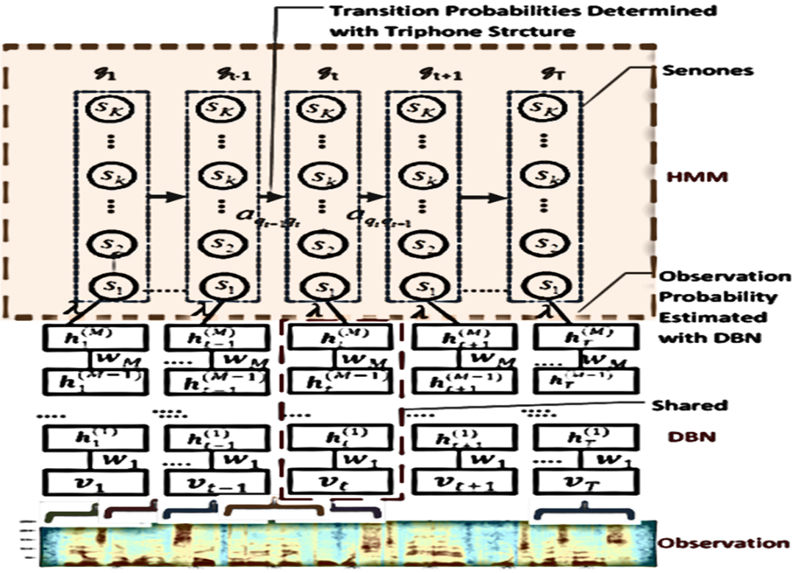
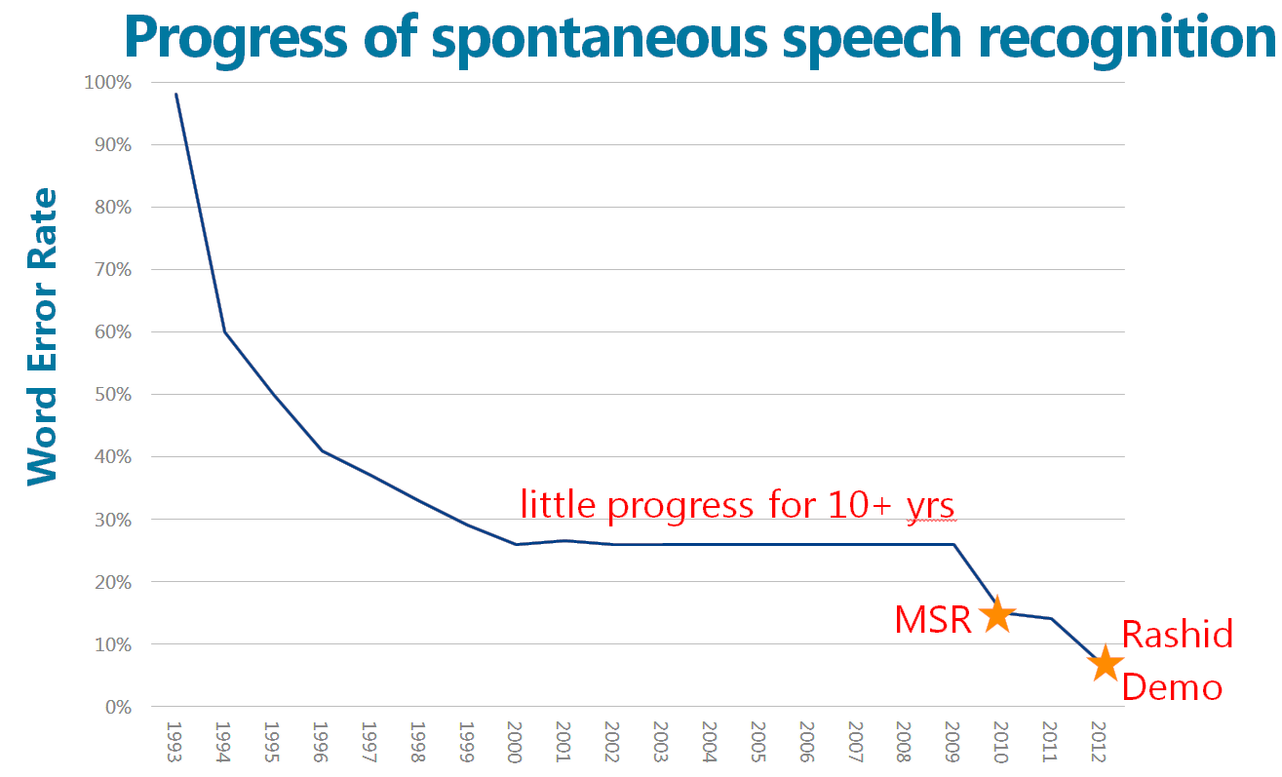
CD-DNN-HMM
Dahl, Yu, Deng, and Acero, “Context-Dependent Pre-trained Deep Neural Networks for Large Vocabulary Speech Recognition,” IEEE Trans. ASLP, Jan. 2012 (also ICASSP 2011)
Seide et al, Interspeech, 2011.
After no improvement for 10+ years by the research community…
…MSR reduced error from ~23% to <13% (and under 7% for Rick Rashid’s S2S demo in 2012)!

Slide 24
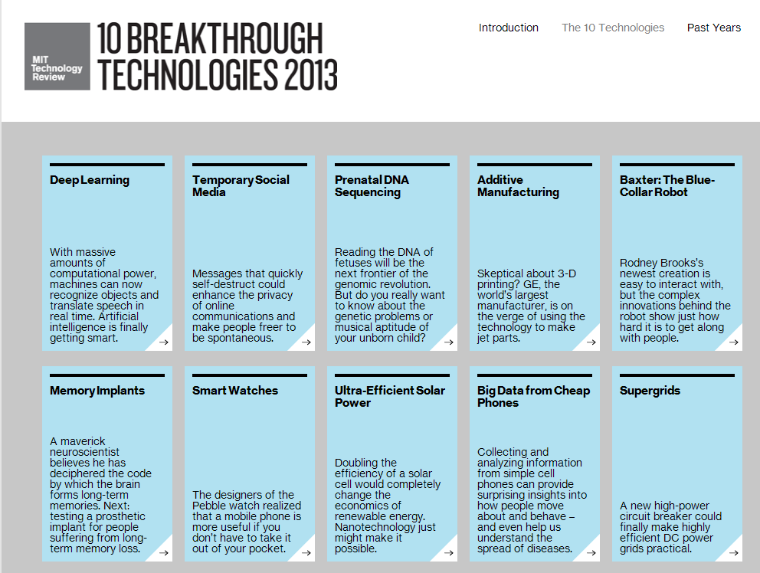

Slide 25
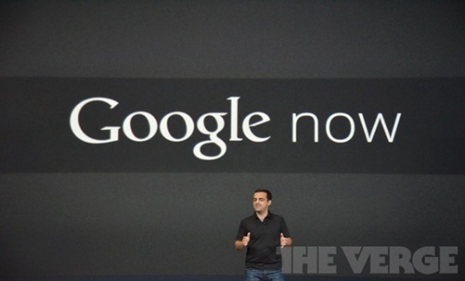
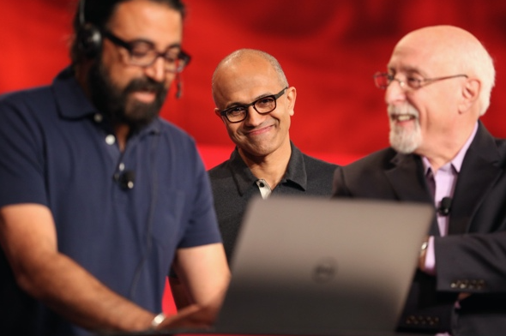

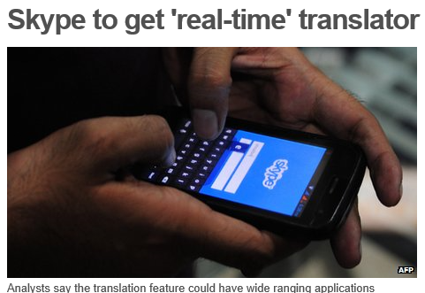

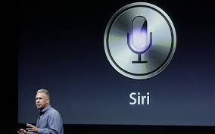
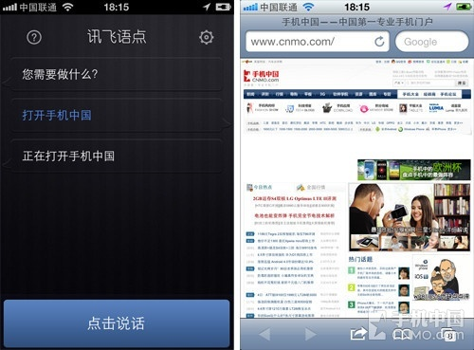
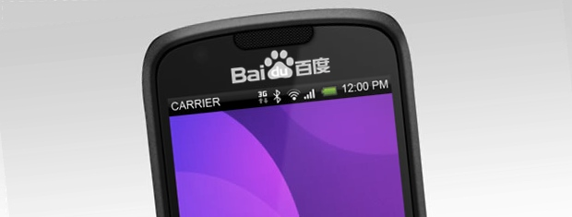
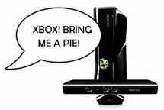
Impact of deep learning in speech technology
Cortana

Slide 26


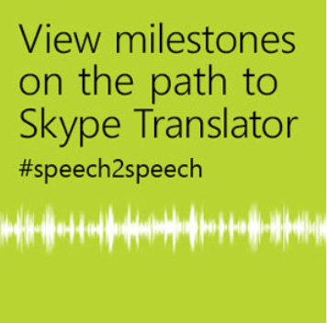
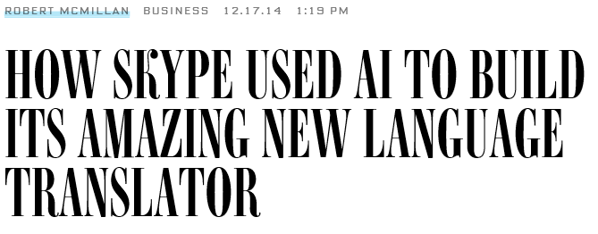
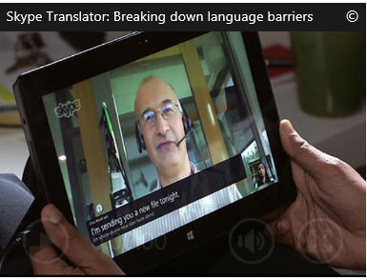
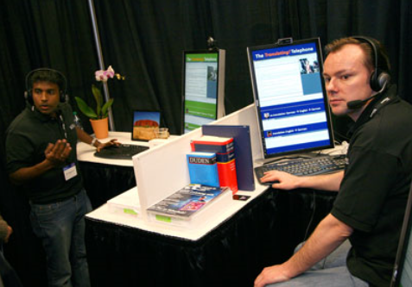
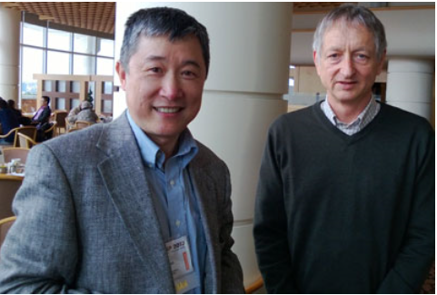



Slide 27
Outline
Introduction
Part I: Some history
How deep learning entered speech recognition (2009-2010)
Generative & discriminative models prior to 2009
Part II: State of the art w. further innovations
Dominated by deep discriminative models
Deep neural nets (DNN) & many of the variants
Part III: Prospects
Integrating deep generative/discriminative models
Deep multimodal and semantic modeling

Slide 28
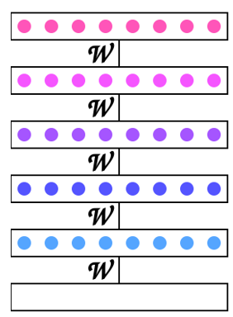
Innovation: Better Optimization
Sequence discriminative training for DNN:
- Mohamed, Yu, Deng: “Investigation of full-sequence training of deep
belief networks for speech recognition,” Interspeech, 2010.
- Kingsbury, Sainath, Soltau. “Scalable minimum Bayes risk training of DNN acoustic models using distributed hessian-free optimization,” Interspeech, 2012.
- Su, Li, Yu, Seide. “Error back propagation for sequence training of CD deep networks for conversational speech transcription,” ICASSP, 2013.
- Vesely, Ghoshal, Burget, Povey. “Sequence-discriminative training of deep neural networks, Interspeech, 2013.
Distributed asynchronous SGD
- Dean, Corrado,…Senior, Ng. “Large Scale Distributed Deep Networks,” NIPS, 2012.
- Sak, Vinyals, Heigold, Senior, McDermott, Monga, Mao. “Sequence Discriminative Distributed Training of Long Short-Term Memory Recurrent Neural Networks,” Interspeech,2014.
Input data X
Notes:
RNN-LSTM: harder for GPU; glad to see CPU-cluster alternative (requiring new alg.)

Slide 29
Innovation: Towards Raw Inputs
Bye-Bye MFCCs (no more cosine transform, Mel-scaling?)
- Deng, Seltzer, Yu, Acero, Mohamed, Hinton. “Binary coding of speech spectrograms using a deep auto-encoder,” Interspeech, 2010.
- Mohamed, Hinton, Penn. “Understanding how deep belief networks perform acoustic modeling,” ICASSP, 2012.
- Li, Yu, Huang, Gong, “Improving wideband speech recognition using mixed-bandwidth training data in CD-DNN-HMM” SLT, 2012
- Deng, J. Li, Huang, Yao, Yu, Seide, Seltzer, Zweig, He, Williams, Gong, Acero. “Recent advances in deep learning for speech research at Microsoft,” ICASSP, 2013.
- Sainath, Kingsbury, Mohamed, Ramabhadran. “Learning filter banks within a deep neural network framework,” ASRU, 2013.
Bye-Bye Fourier transforms?
- Jaitly and Hinton. “Learning a better representation of speech sound waves using RBMs,” ICASSP, 2011.
- Tuske, Golik, Schluter, Ney. “Acoustic modeling with deep neural networks using raw time signal for LVCSR,” Interspeech, 2014.
- Golik et al, “Convolutional NNs for acoustic modeling of raw time signals in LVCSR,” Interspeech, 2015.
- Sainath et al. “Learning the Speech Front-End with Raw Waveform CLDNNs,” Interspeech, 2015
DNN as hierarchical nonlinear feature extractors:
- Seide, Li, Chen, Yu. “Feature engineering in context-dependent deep neural networks for conversational speech transcription, ASRU, 2011.
- Yu, Seltzer, Li, Huang, Seide. “Feature learning in deep neural networks - Studies on speech recognition tasks,” ICLR, 2013.
- Yan, Huo, Xu. “A scalable approach to using DNN-derived in GMM-HMM based acoustic modeling in LVCSR,” Interspeech, 2013.
- Deng, Chen. “Sequence classification using high-level features extracted from deep neural networks,” ICASSP, 2014.
Input data X

Slide 30
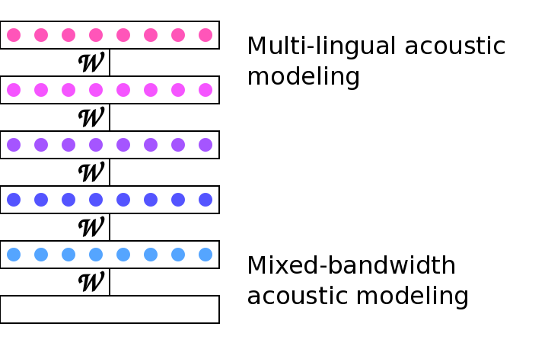
Innovation: Transfer/Multitask Learning & Adaptation
Adaptation to speakers &
environments (i-vectors)
Too many references to list & organize

Slide 31
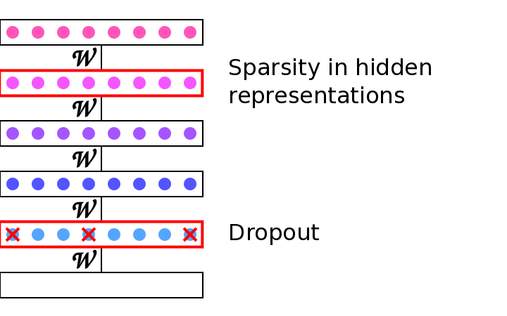
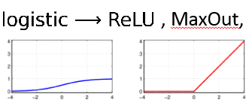
Innovation: Better regularization & nonlinearity
x
x
x
x
x
x
Input data X

Slide 32
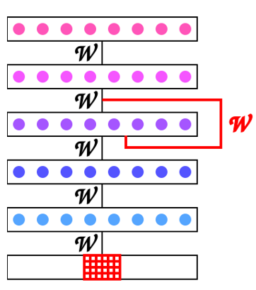
Innovation: Better architectures
Recurrent Nets (bi-directional RNN/LSTM) and Conv Nets (CNN) are superior to fully-connected DNNs
Sak, Senior, Beaufays. “LSTM Recurrent Neural Network architectures for large scale acoustic modeling,” Interspeech,2014.
Soltau, Saon, Sainath. ”Joint Training of Convolutional and Non-Convolutional Neural Networks,” ICASSP, 2014.

Slide 33
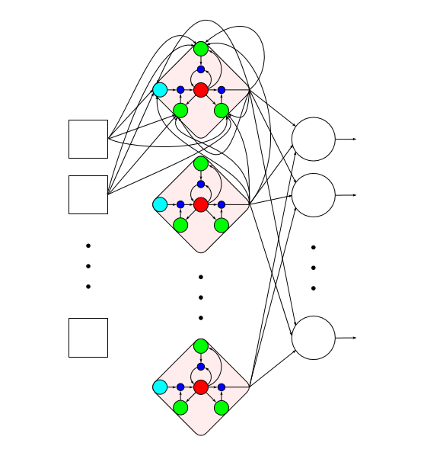
LSTM Cells in an RNN

Slide 34
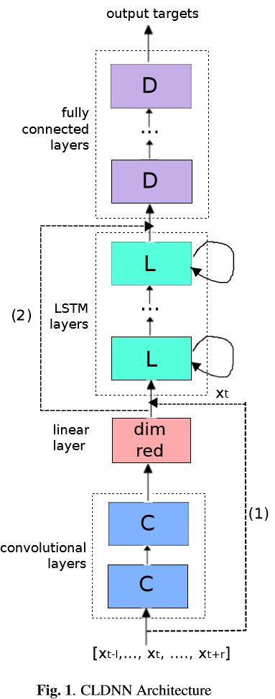


Innovation: Ensemble Deep Learning
Ensembles of RNN/LSTM, DNN, & Conv Nets (CNN) give huge gains (state of the art):
T. Sainath, O. Vinyals, A. Senior, H. Sak. “Convolutional, Long Short-Term Memory, Fully Connected Deep Neural Networks,” ICASSP 2015.
L. Deng and John Platt, Ensemble Deep Learning for Speech Recognition, Interspeech, 2014.
G. Saon, H. Kuo, S. Rennie, M. Picheny. “The IBM 2015 English conversational telephone speech recognition system,” arXiv, May 2015. (8% WER on SWB-309h)

Slide 35


Innovation: Better learning objectives/methods
Use of CTC as a new objective in RNN/LSTM with end2end learning drastically simplifies ASR systems
Predict graphemes or words directly; no pron. dictionaries; no CD; no decision trees
Use of “Blank” symbols may be equivalent to a special HMM state tying scheme
CTC/RNN has NOT replaced HMM (left-to-right)
Relative 8% gain by CTC has been shown by a very
limited number of labs
A. Graves and N. Jaitly. “Towards End-to-End Speech Recognition with Recurrent Neural Networks,” ICML, 2014.
A. Hannun, A. Ng et al. “DeepSpeech: Scaling up End-to-End Speech Recognition,” arXiv Nov. 2014.
A. Maas et al. “Lexicon-Free Conversational ASR with NN,” NAACL, 2015
H. Sak et al. “Learning Acoustic Frame Labeling for ASR with RNN,” ICASSP, 2015
H. Sak, A. Senior, K. Rao, F. Beaufays. “Fast and Accurate Recurrent Neural Network Acoustic Models for Speech Recognition,” Interspeech, 2015

Slide 36


Innovation: A new paradigm for speech recognition
Seq2seq learning with attention mechanism (borrowed from NLP-MT)
W. Chan, N. Jaitly, Q. Le, O. Vinyals. “Listen, attend, and spell,” arXiv, 2015.
J. Chorowski, D. Bahdanau, D. Serdyuk, K. Cho, Y. Bengio. “Attention-Based Models for Speech Recognition,” arXiv, 2015 (accepted to NIPS).

Slide 37
A Perspective on Recent Innovations
All above deep learning innovations are based on supervised, discriminative learning of DNN and recurrent variants
Capitalizing on big, labeled data
Incorporating monotonic-sequential structure of speech (non-monotonic for language, later)
Hard to incorporate many other aspects of speech knowledge with (e.g. speech distortion model)
Hard to do semi- and unsupervised learning
➔Deep generative modeling may overcome such difficulties
Li Deng and Roberto Togneri, Chapter 6: Deep Dynamic Models for Learning Hidden Representations of Speech Features, pp. 153-196, Springer, December 2014.
Li Deng and Navdeep Jaitly, Chapter 2: Deep discriminative and generative models for pattern recognition, ~30 pages, in Handbook of Pattern Recognition and Computer Vision: 5th Edition, World Scientific Publishing, Jan 2016.

Slide 38
Outline
Introduction
Part I: Some history
How deep learning entered speech recognition (2009-2010)
Generative & discriminative models prior to 2009
Part II: State of the art
Dominated by deep discriminative models
Deep neural nets (DNN) & many of the variants
Part III: Prospects
Integrating deep generative/discriminative models
Deep multimodal and semantic modeling

Slide 39
Bring back deep generative models
New advances in variational inference/learning inspired by DNN (since 2014)
Strengths of generative models missing in DNNs
→Domain knowledge and dependency modeling (2015 book): e.g.
how noisy speech observations are composed of clean speech & distortions
vs. brute-force simulating noisy speech data
→Unsupervised learning:
millions of hrs of speech data available without labels
vs. thousands of hrs of data with labels to train SOTA speech systems today
 | Deep Neural Nets | Deep Generative Models
Structure | Graphical; info flow: bottom-up | Graphical; info flow: top-down
Incorp constraints & domain knowledge | Hard | Easy
Unsupervised | Hard or impossible | Not easy, but at least possible
Interpretation | Harder | Easier (generative “story” on data and hidden variables)
Representation | Distributed | Localist (mostly); can be distributed also
Inference/decode | Easy | Harder (but note recent progress)
Scalability/compute | Easier (regular computes/GPU) | Harder (but note recent progress)
Incorp. uncertainty | Hard | Easy
Empirical goal | Classification, feature learning, … | Classification (via Bayes rule), latent variable inference…
Terminology | Neurons, activation/gate functions, weights … | Random vars, stochastic “neurons”, potential function, parameters …
Learning algorithm | A single, unchallenged, algorithm -- BackProp | A major focus of open research, many algorithms, & more to come
Evaluation | On a black-box score – end performance | On almost every intermediate quantity
Implementation | Hard (but increasingly easier) | Standardized but insights needed
Experiments | Massive, real data | Modest, often simulated data
Parameterization | Dense matrices | Sparse (often PDFs); can be dense
Notes:
Expanding from Eric Xing’s list
Pros and cons of both machineries; Let’s take the best of both worlds, as the main theme of this talk.
For “learning algorithms”: A major focus of open research, many algorithms, & more to come → this includes back-prop (hot in graphical models now).

Slide 40
On unsupervised speech recognition using joint deep generative/discriminative models
Deep generative models not successful in 90’s & early 2000’s
Computers were too slow
Models were too simple from text to speech waves
Still true → need speech scientists to work harder with technologists
And when generative models are not good enough, discriminative models and learning (e.g., RNN) can help a lot
Further, can iterate between the two, like wake-sleep (algorithm)
Inference/learning methods for deep generative models not mature at that time
Only partially true today
← due to recent big advances in machine learning
Based on new ways of thinking about generative graphical modeling motivated by the availability of deep learning tools (e.g. DNN)

Slide 41
Advances in Inference Algms for Deep Generative Models
Kingma & Welling 2014 (ICLR/ICML/NIPS); Rezende et al. 2014 (ICML); Ba et al, 2015 (NIPS)
ICML-2014 Talk Monday June 23, 15:20
In Track F (Deep Learning II)
“Efficient Gradient Based Inference through Transformations between
Bayes Nets and Neural Nets”
Other solutions to solve the "large variance problem“ in variational inference:
-Variational Bayesian Inference with Stochastic Search [D.M. Blei, M.I. Jordan and J.W. Paisley, 2012]
-Fixed-Form Variational Posterior Approximation through Stochastic Linear Regression [T. Salimans and A. Knowles, 2013].
-Black Box Variational Inference. [R. Ranganath, S. Gerrish and D.M. Blei. 2013]
-Stochastic Variational Inference [M.D. Hoffman, D. Blei, C. Wang and J. Paisley, 2013]
-Estimating or propagating gradients through stochastic neurons. [Y. Bengio, 2013].
-Neural Variational Inference and Learning in Belief Networks. [A. Mnih and K. Gregor, 2014, ICML]
-Stochastic backprop & approximation inference in deep generative models [D. Rezende, S. Mohamed, D. Wierstra, 2014]
-Semi-supervised learning with deep generative models [K. Kingma, D. Rezende, S. Mohamed, M. Welling, 2014, NIPS]
-auto-encoding variational Bayes [K. Kingma, M. Welling, 2014, ICML]
-Learning stochastic recurrent networks [Bayer and Osendorfer, 2015 ICLR]
-DRAW: A recurrent neural network for image generation. [K. Gregor, Danihelka, Rezende, Wierstra, 2015]
- Plus a number of NIPS-2015 papers, to appear.
Slide provided by Max Welling (ICML-2014 tutorial) w. my updates on references of 2015 and late 2014

Slide 42



Another direction: Multi-Modal Learning (text, image, speech) --- a “human-like” speech acquisition & image understanding model
Distance(s,t)
Distance(i,t)
Distant supervised learning
Project speech, image, and text to the same “semantic” space
Learn associations between difference modalities
Refs: Huang et al. “Learning deep structured semantic models (DSSM) for web search using clickthrough data,” CIKM, 2013; etc.
W₄
W₄
W₄
H3
H3
H3
H3
H3
W₃
H3
W₃
W₃
H2
H2
H2
W₂
W₂
W₂
Softmax layer
H1
H1
H1
W₁
W₁
W₁
Fully connected
Fully connected
Input i
Input t
Input s
Image features i
Text string t
Speech features s
Convolution/pooling
Convolution/pooling
Convolution/pooling
Convolution/pooling
Convolution/pooling
Raw Image pixels
Notes:
Many subtleties; boxes in image need to align with phrases in the sentence description of the corresponding caption

Slide 43
Summary
Speech recognition is the first success case of deep learning at industry scale
Early NN & deep/dynamic generative models did not succeed, but
They provided seeding work for inroads of DNNs to speech recognition (2009)
Academic/industrial collaborations; Careful comparisons of two types of models
Use of (big) context-dependent HMM states as DNN output layers lead to huge error reduction while keeping decoding efficiency similar to old GMM-HMMs.
With large labeled training data, no need for generative pre-training of DNNs/RNNs (2010 at MSR)
Current SOTA is based on LSTM-RNN, CNN, DNN with ensemble learning, no generative components
Many weaknesses of this deep discriminative architecture are identified & analyzed → the need to bring back deep generative models

Slide 44
Summary: Future Directions
With supervised data, what will be the limit for growing accuracy wrt increasing amounts of labeled speech data?
Beyond this limit or when labeled data are exhausted or non-economical to collect, how will unsupervised deep learning emerge?
Three axes for future advances:
Multimodal learning
(distant supervised learning)
Semi/Unsupervised deep learning:
-integrated generative/discriminative models
-generative: embed knowledge/constraints;
exploit powerful priors;
define high-capacity NN architectures for discriminative nets;
Further push to the limit of
supervised deep learning

Slide 45
Thank You
& backup slides
Stop mooching, moocher -_- !!! -Lloyd

Slide 46
Additional References
Auli, M., Galley, M., Quirk, C. and Zweig, G., 2013. Joint language and translation modeling with recurrent neural networks. In EMNLP.
Auli, M., and Gao, J., 2014. Decoder integration and expected bleu training for recurrent neural network language models. In ACL.
Baker, J., Li Deng, Jim Glass, S. Khudanpur, C.-H. Lee, N. Morgan, and D. O'Shgughnessy, Research Developments and Directions in Speech Recognition and Understanding, Part 1, in IEEE Signal Processing Magazine, vol. 26, no. 3, pp. 75-80, 2009.
Baker, J., Li Deng, S. Khudanpur, C.-H. Lee, J. Glass, and N. Morgan, Updated MINDS Report on Speech Recognition and Understanding, in IEEE Signal Processing Magazine, vol. 26, no. 4, July 2009.
Bengio, Y., 2009. Learning deep architectures for AI. Foundumental Trends Machine Learning, vol. 2.
Bengio, Y., Courville, A., and Vincent, P. 2013. Representation learning: A review and new perspectives. IEEE Trans. PAMI, vol. 38, pp. 1798-1828.
Bengio, Y., Ducharme, R., and Vincent, P., 2000. A Neural Probabilistic Language Model, in NIPS.
Bridle, J., L. Deng, J. Picone, H. Richards, J. Ma, T. Kamm, M. Schuster, S. Pike, R. Reagan, An investigation of segmental hidden dynamic models of speech coarticulation for automatic speech recognition. Final Report for 1998 Workshop on Langauge Engineering, CLSP (Johns Hopkins, 1998.
Collobert, R., Weston, J., Bottou, L., Karlen, M., Kavukcuoglu, K., and Kuksa, P., 2011. Natural language processing (almost) from scratch. in JMLR, vol. 12.
Dahl, G., Yu, D., Deng, L., and Acero, 2012. A. Context-dependent, pre-trained deep neural networks for large vocabulary speech recognition, IEEE Trans. Audio, Speech, & Language Proc., Vol. 20 (1), pp. 30-42.
Deerwester, S., Dumais, S. T., Furnas, G. W., Landauer, T., and Harshman, R. 1990. Indexing by latent semantic analysis. J. American Society for Information Science, 41(6): 391-407
Deng, L. A dynamic, feature-based approach to the interface between phonology & phonetics for speech modeling and recognition, Speech Communication, vol. 24, no. 4, pp. 299-323, 1998.
Deng, L. Computational Models for Speech Production, in Computational Models of Speech Pattern Processing, pp. 199-213, Springer Verlag, 1999.
Deng, L. Switching Dynamic System Models for Speech Articulation and Acoustics, in Mathematical Foundations of Speech and Language Processing, vol. 138, pp. 115-134, Springer Verlag, 2003.
Deng, L., K. Hassanein, M. Elmasry, Analysis of the correlation structure for a neural predictive model with application to speech recognition. Neural Networks. 7(2), 331–339, 1994.
Deng L., G. Ramsay, and D. Sun, Production models as a structural basis for automatic speech recognition," Speech Communication (special issue on speech production modeling), in Speech Communication, vol. 22, no. 2, pp. 93-112, August 1997.
Deng L. and J. Ma, Spontaneous Speech Recognition Using a Statistical Coarticulatory Model for the Vocal Tract Resonance Dynamics, Journal of the Acoustical Society of America, 2000.
Deng, L. and O’Shaughnessy, O. Speech Processing—A Dynamic and Optimization-Oriented Approach, Marcel Dekker, New York, 2003
Deng L. and Yu, L. DEEP LEARNING: Methods and Applications, NOW Publishings, 2014.
Deng L. and Xiao Li, Machine Learning Paradigms for Speech Recognition: An Overview, in IEEE Transactions on Audio, Speech, and Language Processing, vol. 21, no. 5, pp. 1060-1089, May 2013.
Deng L. and Xuedong Huang, Challenges in Adopting Speech Recognition, in Communications of the ACM, vol. 47, no. 1, pp. 11-13, January 2004.
Deng, L., Seltzer, M., Yu, D., Acero, A., Mohamed, A., and Hinton, G., Binary Coding of Speech Spectrograms Using a Deep Auto-encoder, Interspeech, 2010.
Deng, L., Tur, G, He, X, and Hakkani-Tur, D. 2012. Use of kernel deep convex networks and end-to-end learning for spoken language understanding, Proc. IEEE Workshop on Spoken Language Technologies.
Deng, L., Yu, D. and Acero, A. 2006. Structured speech modeling, IEEE Trans. on Audio, Speech and Language Processing, vol. 14, no. 5, pp. 1492-1504.
Deng, L., Geoffrey Hinton, and Brian Kingsbury, New types of deep neural network learning for speech recognition and related applications: An overview, ICASSP, 2013.
Deng L. and Dong Yu, Use of Differential Cepstra as Acoustic Features in Hidden Trajectory Modeling for Phonetic Recognition, ICASSP, 2007.
Deng, L., Xiaodong He, and Jianfeng Gao, Deep Stacking Networks for Information Retrieval, ICASSP, 2013.
Deng L. and Dong Yu, Deep Convex Network: A Scalable Architecture for Speech Pattern Classification, in Interspeech, 2011.
Deng, L., Yu, D., and Platt, J. 2012. Scalable stacking and learning for building deep architectures, Proc. ICASSP.
Deoras, A., and Sarikaya, R., 2013. Deep belief network based semantic taggers for spoken language understanding, in INTERSPEECH.
Devlin, J., Zbib, R., Huang, Z., Lamar, T., Schwartz, R., and Makhoul, J., 2014. Fast and Robust Neural Network Joint Models for Statistical Machine Translation, ACL.

Slide 47
Additional References
Frome, A., Corrado, G., Shlens, J., Bengio, S., Dean, J., Ranzato, M., and Mikolov, T., 2013. DeViSE: A Deep Visual-Semantic Embedding Model, Proc. NIPS.
Gao, J., He, X., Yih, W-t., and Deng, L. 2014a. Learning continuous phrase representations for translation modeling. In ACL.
Gao, J., He, X., and Nie, J-Y. 2010. Clickthrough-based translation models for web search: from word models to phrase models. In CIKM.
Gao, J., Pantel, P., Gamon, M., He, X., and Deng, L. 2014. Modeling interestingness with deep neural networks. In EMNLP
Gao, J., Toutanova, K., Yih., W-T. 2011. Clickthrough-based latent semantic models for web search. In SIGIR.
Gao, J., Yuan, W., Li, X., Deng, K., and Nie, J-Y. 2009. Smoothing clickthrough data for web search ranking. In SIGIR.
Gao, J., and He, X. 2013. Training MRF-based translation models using gradient ascent. In NAACL-HLT.
Graves, A., Jaitly, N., and Mohamed, A., 2013a. Hybrid speech recognition with deep bidirectional LSTM, Proc. ASRU.
Graves, A., Mohamed, A., and Hinton, G., 2013. Speech recognition with deep recurrent neural networks, Proc. ICASSP.
He, X. and Deng, L., 2013. Speech-Centric Information Processing: An Optimization-Oriented Approach, in Proceedings of the IEEE.
He, X. and Deng, L., 2012. Maximum Expected BLEU Training of Phrase and Lexicon Translation Models , ACL.
He, X., Deng, L., and Chou, W., 2008. Discriminative learning in sequential pattern recognition, Sept. IEEE Sig. Proc. Mag.
Hinton, G., Deng, L., Yu, D., Dahl, G., Mohamed, A., Jaitly, N., Senior, A., Vanhoucke, V., Nguyen, P., Sainath, T., and Kingsbury, B., 2012. Deep Neural Networks for Acoustic Modeling in Speech Recognition, IEEE Signal Processing Magazine, vol. 29, no. 6, pp. 82-97.
Hinton, G., and Salakhutdinov, R., 2010. Discovering binary codes for documents by learning deep generative models. Topics in Cognitive Science.
Hu, Y., Auli, M., Gao, Q., and Gao, J. 2014. Minimum translation modeling with recurrent neural networks. In EACL.
Huang, E., Socher, R., Manning, C, and Ng, A. 2012. Improving word representations via global context and multiple word prototypes, Proc. ACL.
Huang, P., He, X., Gao, J., Deng, L., Acero, A., and Heck, L. 2013. Learning deep structured semantic models for web search using clickthrough data. In CIKM.
Hutchinson, B., Deng, L., and Yu, D., 2012. A deep architecture with bilinear modeling of hidden representations: Applications to phonetic recognition, Proc. ICASSP.
Hutchinson, B., Deng, L., and Yu, D., 2013. Tensor deep stacking networks, IEEE Trans. Pattern Analysis and Machine Intelligence, vol. 35, pp. 1944 - 1957.
Kiros, R., Zemel, R., and Salakhutdinov, R. 2013. Multimodal Neural Language Models, Proc. NIPS Deep Learning Workshop.
Koehn, P. 2009. Statistical Machine Translation. Cambridge University Press.
Krizhevsky, A., Sutskever, I, and Hinton, G., 2012. ImageNet Classification with Deep Convolutional Neural Networks, NIPS.
Le, H-S, Oparin, I., Allauzen, A., Gauvain, J-L., Yvon, F., 2013. Structured output layer neural network language models for speech recognition, IEEE Transactions on Audio, Speech and Language Processing.
LeCun, Y., Bottou, L., Bengio, Y., and Haffner, P. 1998. Gradient-based learning applied to document recognition, Proceedings of the IEEE, Vol. 86, pp. 2278-2324.
Lee, L., H. Attias, Li Deng, and P. Fieguth, A Multimodal Variational Approach to Learning and Inference in Switching State Space Models, ICASSP, 2004.
Ma, J. and L. Deng, Target-directed mixture dynamic models for spontaneous speech recognition. IEEE Trans. Audio Speech Process. 12(1), 47–58, 2004
Mesnil, G., He, X., Deng, L., and Bengio, Y., 2013. Investigation of Recurrent-Neural-Network Architectures and Learning Methods for Spoken Language Understanding, in Interspeech.
Mikolov, T. 2012. Statistical Language Models based on Neural Networks, Ph.D. thesis, Brno University of Technology.
Mikolov, T., Chen, K., Corrado, G., and Dean, J. 2013. Efficient estimation of word representations in vector space, Proc. ICLR.
Mikolov, T., Kombrink,. S., Burget, L., Cernocky, J., Khudanpur, S., 2011. Extensions of Recurrent Neural Network LM. ICASSP.
Mikolov, T., Yih, W., Zweig, G., 2013. Linguistic Regularities in Continuous Space Word Representations. In NAACL-HLT.
Mohamed, A., G. Dahl, G. Hinton, Acoustic modeling using deep belief networks. IEEE Trans. Audio Speech Lang. Process. 20(1), 14–22, 2012 & 2009
Mohamed, A., Yu, D., and Deng, L. 2010. Investigation of full-sequence training of deep belief networks for speech recognition, Proc. Interspeech.
Ngiam, J., Khosla, A., Kim, M., Nam, J., Lee, H., and Ng, A. 2011. Multimodal deep learning, Proc. ICML.

Slide 48
Additional References
Picone, P., S. Pike, R. Regan, T. Kamm, J. Bridle, L. Deng, Z. Ma, H. Richards, M. Schuster, 1999. Initial evaluation of hidden dynamic models on conversational speech, ICASSP.
Robinson, T. An application of recurrent nets to phone probability estimation. IEEE Trans. Neural Networks. 5(2), 298–305, 1994.
Sainath, T., Mohamed, A., Kingsbury, B., and Ramabhadran, B. 2013. Convolutional neural networks for LVCSR, Proc. ICASSP.
Salakhutdinov R., and Hinton, G., 2007 Semantic hashing. in Proc. SIGIR Workshop Information Retrieval and Applications of Graphical Models
Schwenk, H., Dchelotte, D., Gauvain, J-L., 2006. Continuous space language models for statistical machine translation, in COLING-ACL
Seide, F., Li, G., and Yu, D. 2011. Conversational speech transcription using context-dependent deep neural networks, Proc. Interspeech
Shen, Y., He, X., Gao, J., Deng, L., and Mesnil, G. 2014. Learning Semantic Representations Using Convolutional Neural Networks for Web Search, in Proceedings of WWW.
Shen, Y., He, X., Gao, J., Deng, L., and Mesnil, G. 2014. A convolutional latent semantic model for web search. CIKM
Shen, X., L. Deng, Maximum likelihood in statistical estimation of dynamical systems: decomposition algorithm and simulation results. Signal Process. 57, 65–79, 1997.
Socher, R., Huval, B., Manning, C., Ng, A., 2012. Semantic compositionality through recursive matrix-vector spaces. In EMNLP.
Socher, R., Lin, C., Ng, A., and Manning, C. 2011. Learning continuous phrase representations and syntactic parsing with recursive neural networks, Proc. ICML.
Socher, R., Perelygin, A., Wu, J., Chuang, J., Manning, C., Ng A., and Potts. C. 2013. Recursive Deep Models for Semantic Compositionality Over a Sentiment Treebank, Proc. EMNLP
Song, X. He, X., Gao. J., and Deng, L. 2014. Learning Word Embedding Using the DSSM. MSR Tech Report.
Song, Y., Wang, H., and He, X., 2014. Adapting Deep RankNet for Personalized Search. Proc. WSDM.
Tur, G., Deng, L., Hakkani-Tur, D., and He, X., 2012. Towards Deeper Understanding Deep Convex Networks for Semantic Utterance Classification, in ICASSP.
Togneri, R., L. Deng, Joint state and parameter estimation for a target-directed nonlinear dynamic system model. IEEE Trans. Signal Process. 51(12), 3061–3070, 2003.
Vinyals, O., Y. Jia, Li Deng, and Trevor Darrell, Learning with Recursive Perceptual Representations, NIPS, 2012.
Wright, S., Kanevsky, D., Deng, L., He, X., Heigold, G., and Li, H. Optimization Algorithms and Applications for Speech and Language Processing, in IEEE Transactions on Audio, Speech, and Language Processing, vol. 21, no. 11. 2013.
Yao, K., Zweig, G., Hwang, M-Y. , Shi, Y., Yu, D., 2013. Recurrent neural networks for language understanding, submitted to Interspeech.
Yann, D., Tur, G., Hakkani-Tur, D., Heck, L., 2014. Zero-Shot Learning and Clustering for Semantic Utterance Classification Using Deep Learning, in ICLR.
Yu, D. and Deng, L. Discriminative pretraining of deep neural networks, US Patent, 2013.
Yu, D., Deng, L., G. Dahl, Roles of pre-training and fine-tuning in context-dependent DBN-HMMs for real-world speech recognition, NIPS Workshop 2010.

Slide 49

Unsupervised learning using deep generative model (ACL, 2013)
Distorted character string Images→ Text
Easier than unsupervised Speech→ Text
47% error reduction over Google’s open-source OCR system
Motivated me to think about unsupervised ASR
and NLP

Slide 50

Power: Character-level LM & generative modeling for unsupervised learning
“Image” data are naturally “generated” by the model quite accurately (like “computer graphics”)
I had the same idea for unsupervised generative Speech-to-Text in 90’s
Not successful because 1) Deep generative models were too simple for generating speech waves
2) Inference/learning methods for deep generative models not mature then
3) Computers were too slow

Slide 51



Deep Generative Model for Image-Text
Deep Generative Model for Speech-Text
(Berg-Kirkpatrick et al., 2013, 2015)
(Deng, 1998; Deng et al, 1997, 2000, 2003, 2006)
L.Deng, A dynamic, feature-based approach to the interface between phonology
& phonetics for speech modeling and recognition, Speech Communication,
vol. 24, no. 4, pp. 299-323, 1998.

Slide 52
Deep Generative Model for Image-Text
Deep Generative Model for Speech-Text
(Berg-Kirkpatrick et al., 2013, 2015)
(Deng, 1998; Deng et al, 2000, 2003, 2006)
Word-level
Language model
Plus
Feature-level
Pronunciation model

Slide 53
Deep Generative Model for Image-Text
Deep Generative Model for Speech-Text
(Berg-Kirkpatrick et al., 2013, 2015)
(Deng, 1998; Deng et al, 2000, 2003, 2006)
Articulatory
dynamics
Easy: likely no “explaining away” problem in
inference and learning
Hard: pervasive “explaining away” problem
due to speech dynamics

Slide 54
Deep Generative Model for Image-Text
Deep Generative Model for Speech-Text
(Berg-Kirkpatrick et al., 2013, 2015)
(Deng, 1998; Deng et al, 2000, 2003, 2006)
Articulatory
To
Acoustics
mapping

Slide 55



In contrast, articulatory-to-acoustics
mapping in ASR is much more complex
During 1997-2000, shallow NNs were used
for this as “universal approximator”
Not successful
Now we have better DNN tool
Even RNN/LSTM tool for dynamic modeling
Very simple, & easy to model accurately

Slide 56



Generative HDM

Slide 57
Further thoughts on unsupervised ASR
Deep generative modeling experiments not successful in 90’s
Computers were too slow
Models were too simple from text to speech waves
Still true → need speech scientists to work harder with technologists
And when generative models are not good enough, discriminative models and learning (e.g., RNN) can help a lot; but to do it? A hint next
Further, can iterate between the two, like wake-sleep (algorithm)
Inference/learning methods for deep generative models not mature at that time
Only partially true today
← due to recent big advances in machine learning
Based on new ways of thinking about generative graphical modeling motivated by the availability of deep learning tools (e.g. DNN)
A brief review next

Slide 58






RNN vs. Generative HDM
Parameterization:
$W_{hh}, W_{hy},$ $W_{xh}$: all unstructured
regular matrices
Parameterization:
$W_{hh}=$M(${\text{ɣ}}_{l}$); sparse system matrix
$W_{Ω}=$(${\text{Ω}}_{l}$); Gaussian-mix params; MLP
$Λ=t_{l}$
Notes:
Parameterizations: HDM --- sparse matrix designed to produce critical damped dynamic behavior with parsimonious set of HYPER-parameters, not learned. We now know how to learn them via BackProp discriminatively.
Mark Liberman emailed:
“… wondered whether there are any real-world problems for which the recurrent neural nets (which can be seen as non-linear autoregressive models) do a better job than (piecewise) linear AR models do. That last question is what led us to your 2007 paper -- it seems clear that the same sort of approach could be used in pitch tracking, which seems like a simpler sort of problem”
----------
From: Mark Liberman [mailto:markyliberman@gmail.com] Sent: Tuesday, January 29, 2013 4:44 PM To: Li Deng Cc: Mark Hasegawa-Johnson (jhasegaw@gmail.com); Douglas O'Shaughnessy; Alex Acero
----------
GH: Inference is difficult in directed models of time series if they are non-linear and they use distributed representations.
So people tend to avoid distributed representations and use exponentially weaker methods (HMM’s) that are based on the idea that each visible frame of data has a single hidden cause. During generation from an HMM, each frame comes from one hidden state of the HMM

Slide 59
RNN vs. Generative HDM
~DNN
~DBN
e.g. Generative pre-training
(analogous to generative DBN pretraining for DNN)
NIPS-2015 paper to appear on simpler dynamic models for a non-ASR application
Better ways of integrating deep generative/discriminative models are possible
- Hint: Example 1 where generative models are used to define the DNN architecture
Notes:
Parameterizations: HDM --- sparse matrix designed to produce critical damped dynamic behavior with parsimonious set of HYPER-parameters, not learned. We now know how to learn them via BackProp discriminatively.
Mark Liberman emailed:
“… wondered whether there are any real-world problems for which the recurrent neural nets (which can be seen as non-linear autoregressive models) do a better job than (piecewise) linear AR models do. That last question is what led us to your 2007 paper -- it seems clear that the same sort of approach could be used in pitch tracking, which seems like a simpler sort of problem”
----------
From: Mark Liberman [mailto:markyliberman@gmail.com] Sent: Tuesday, January 29, 2013 4:44 PM To: Li Deng Cc: Mark Hasegawa-Johnson (jhasegaw@gmail.com); Douglas O'Shaughnessy; Alex Acero
----------
GH: Inference is difficult in directed models of time series if they are non-linear and they use distributed representations.
So people tend to avoid distributed representations and use exponentially weaker methods (HMM’s) that are based on the idea that each visible frame of data has a single hidden cause. During generation from an HMM, each frame comes from one hidden state of the HMM

Slide 60


Interpretable deep learning: Deep generative model
Constructing interpretable DNNs based on generative topic models
End-to-end learning by mirror-descent backpropagation
→ to maximize posterior probability p(y|x)
y: output (win/loss), and x: input feature vector
Mirror Descent
Algorithm (MDA)
J. Chen, J. He, Y. Shen, L. Xiao, X. He, J. Gao, X. Song, and L. Deng, “End-to-end Learning of Latent Dirichlet Allocation by Mirror-Descent Back Propagation”, accepted NIPS2015.

Slide 61






Recall: (Shallow) Generative Model
…
“TOPICS”
as hidden layer
war
animals
computers
Iraqi
the
Matlab
slide revised from: Max Welling

